Slide 1
Automating Stock price
UNIX SYSTEM PROGRAMMING PROJECT
TOPIC:
By:
Sunag P
Sumith Hegde
Venkatesh C
Notes:
‹#›

Slide 2
ABSTRACT
Investing in the stock market is very closely related to the ups and downs of stock prices.Predicting stock market movements is a well-known problem of interest. Now-a- days social media is perfectly representing the public sentiment and opinion about current events.
In this project we have discussed about a Shell Script based project that automates the stock price details based on NIFTY50 website from time to time and keeps track of the stocks bought by the user and automatically notifies the user if there are drastic fluctuations in the stock prices bought by them.
Notes:
‹#›

Slide 3
INTRODUCTION
The development of stock prices is an important indicator for investors to find out market behavior. Investment grade announcements are often associated as one of the events that can affect stock price fluctuations.
Many online trading platforms provide analysis of stocks, which helps the users to find the
status of the stock market. This also helps them predict the situation of stocks in upcoming
days and shape their decisions .
Notifying the fluctuations in the price at the right time becomes very crucial and helps them in making the right decision .
Our project does the same by sending email and whatsapp messages from time to time and keeps track of the stocks bought by the user and automatically notifies the user if there are drastic fluctuations in the stock prices.
Notes:
‹#›

Slide 4
PROBLEM STATEMENT
Requirement of a tool to get updates about stock prices periodically and quickly update the user whenever there are notable fluctuations so as to help users in making suitable decisions.
Notes:
‹#›

Slide 5
API’s USED
CRONTAB
It is a time based job-scheduler in unix like computer operating system.We use
this to automate the task of updating prices of stocks.
CURL
curl is a command-line tool for getting or sending files using URL syntax
From all the data obtained from the output of curl, only necessary information can be extracted for further use.
Notes:
‹#›

Slide 6
API’s USED
SMTPLIB
The SMTPLIB is used for sending the clients notification about the price fluctuations through emails.
PYWHATKIT
Python API for sending the clients notification about the price fluctuations through WhatsApp.
Notes:
‹#›

Slide 7
IMPLEMENTATION
https://github.com/SunagP/Stock-Automation_ShellScript-
Notes:
‹#›

Slide 8
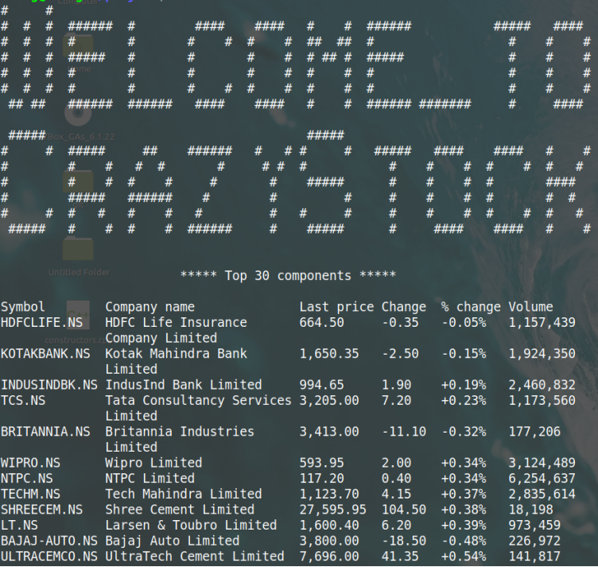
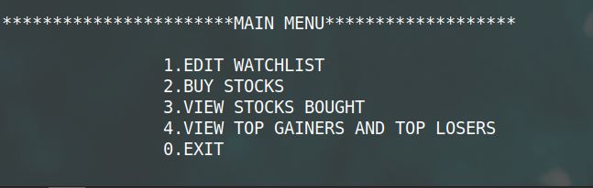
Results/Snapshots
Fig-2 Main menu
Fig-1 Welcome page
Notes:
‹#›

Slide 9
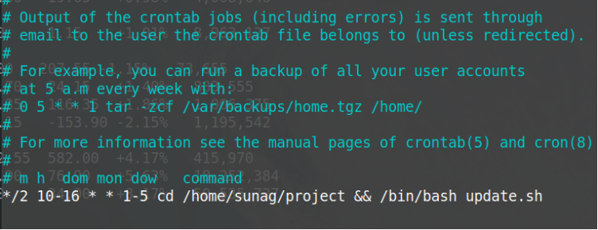
Fig-3 Automatic updation of stock price every 2 minutes using crontab

Slide 10
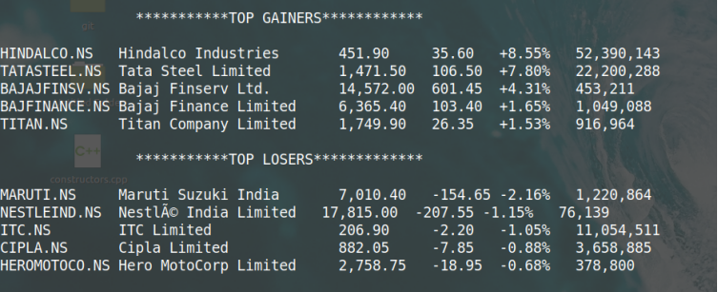
Fig-4 top gainers and top losers

Slide 11
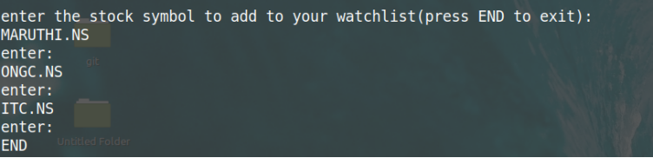
Fig-5 Adding stocks to Watch-list

Slide 12
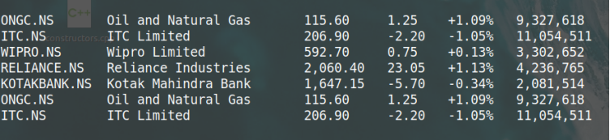
Fig-6 Bought stocks

Slide 13
THANK YOU……..

